Slide 1

Web scraping to gain company insights
12/02/2025

Slide 2
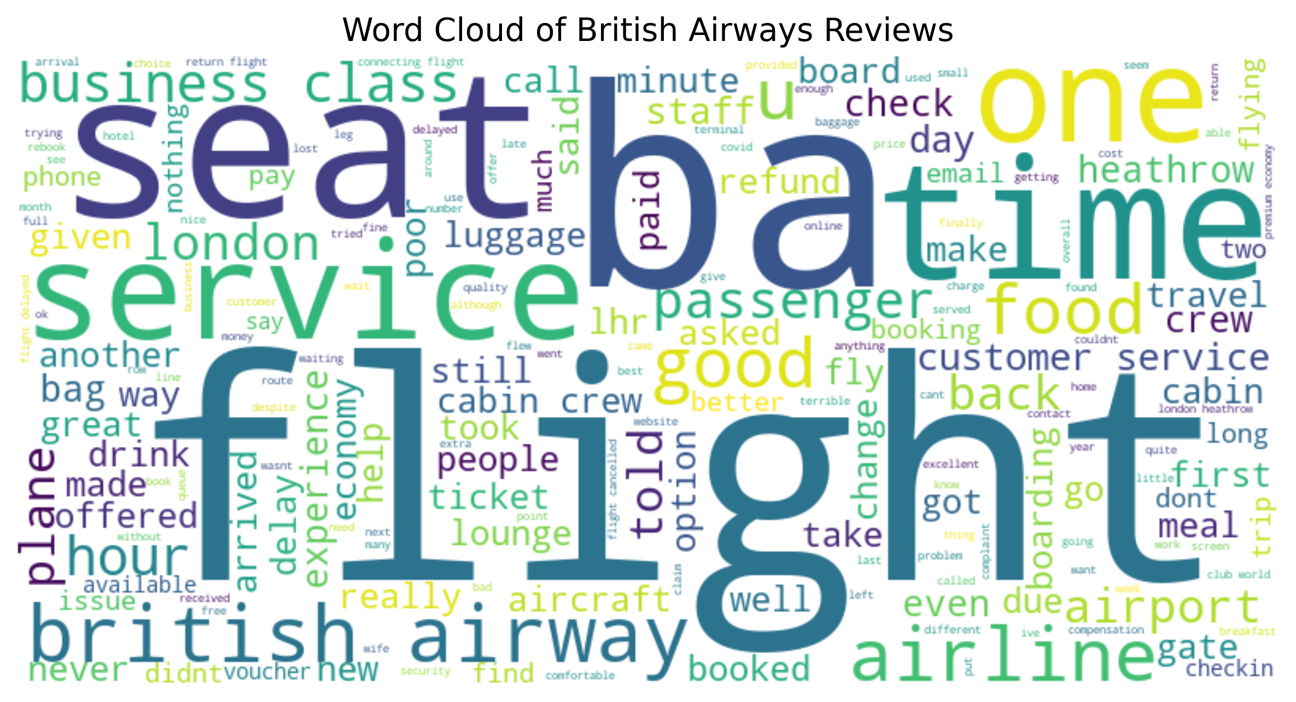
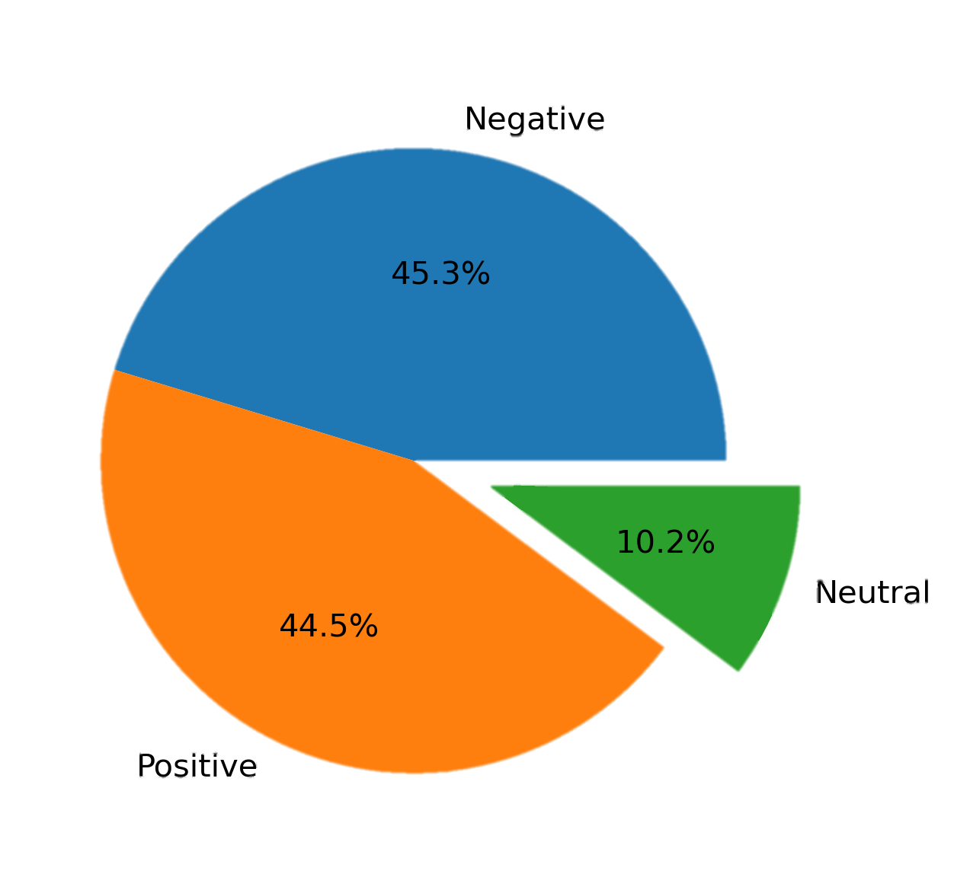
INSIGHTS FROM CUSTOMER REVIEWS
Sentiment Distribution
Positive Reviews – 445
Negative Reviews – 453
Neutral Reviews – 102
Key Takeaways
Majority Sentiment : Most reviews are negative ,indicating dissatisfaction
Neutral Proportion : 10.2% of customers shows mixed experience
Positive Feedback : 44.5% customers are satisfied, but still need improvements

